Slide 1

Active Communities
Let’s Get C-K Rolling
Presentation to the Chatham Sunrise Rotary Club
Don Shropshire, GM,
Community Development & Planning Services
February 9, 2010

Slide 2
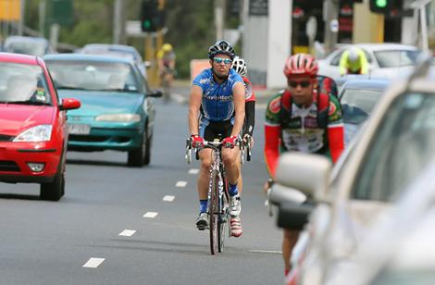
Agenda
Active Communities
  goal, 2010 plan
How can you help?
Discussion

Slide 3
A Perfect Storm is Brewing
Changes between 1994 & 2005
All Canadian
+ 77 % High blood pressure
+ 45 % Diabetes
+ 18 % Obesity
35 to 49 years of age
+ 127% High blood pressure
+ 64 % Diabetes
+ 20% Obesity
Notes:
January 26, 2010
The signs of this impending crisis are clearly evident. Between 1994 and 2005, rates of high blood pressure among Canadians skyrocketed by 77%, diabetes by 45% and obesity by 18% - affecting both younger and older Canadians. Moreover, even younger age groups are experiencing increases in risk: among those 35 to 49 years of age, for example, the prevalence of high blood pressure increased 127%, diabetes by 64% and obesity by 20% - all major risk factors for heart disease.
"Up to this point we've had a patchwork quilt of prevention and treatment initiatives aimed at addressing some, but not all, of the risk factors affecting Canadians," says Stephen Samis, Director of Health Policy, Heart and Stroke Foundation of Canada. "The magnitude of this problem has become so large, the only way forward is to implement a comprehensive, Canadian heart-health strategy that focuses on at-risk and disadvantaged populations, addresses the disparities between provinces and territories and integrates Canada's fragmented system of cardiac care services."
The at-risk and disadvantaged populations in Canada include: the unprecedented growing number of young Canadian adults who are obese and overweight; the largest cohort of Boomers (50-64 years) in Canada's history entering a stage where they are at a higher risk for heart disease; our Aboriginal peoples who are experiencing a full-blown cardiovascular crisis; more women entering their young adult years at higher risk for heart disease, which could overwhelm the healthcare system with an entire new generation of patients; and, some of Canada's fastest growing ethno-cultural communities who are pre-disposed to a heavier burden of risk factors and heart disease.

Slide 4
Active Communities Mandate
Ultimate goal = a healthy community
Develop an Active Communities “plan of action” & oversee implementation of the “plan”

Slide 5
C-K’s Strategic Objectives
A1. Provide sufficient capacity to sustain community health & economic growth
A2. Exceed standards for health protection &
promotion
A3. Promote healthy lifestyles
Notes:
Reference recent Heart and Stroke Canada study increased incidence incident in diabetes, strokes and heart disease (smoking and lack of activity)

Slide 6
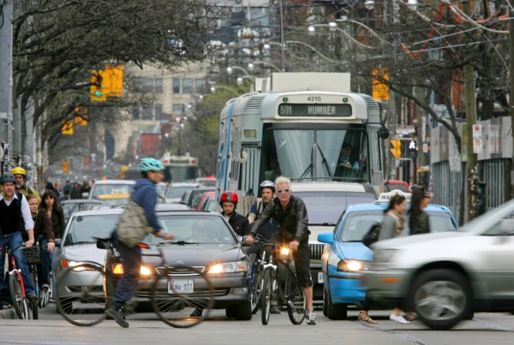
“At the same time public health and the environment are given a boost when we make it more tempting to go by
bicycle on a daily basis.”
Ref. Danish Cyclist Federation
“
By riding bicycles…we are improving the quality of our air, soil and water.”
C-K Community Strategic Plan

Slide 7
99% of all car trips in the US terminate in a free parking space.
Consider the impact on cycling if we were to provide the same facilities for their bikes.
Let’s strike a healthier balance.

Slide 8
Tomorrow’s bike traffic will be different than today’s
  Chatham-Kent Today: 0.5% Trips By Bike
  Canadian Average: 2% Trips By Bike
  European Communities: 25% +
  Typical North American Goal: 15%
  Design Year: Year 10
Notes:
At the last census (2006) 6% of C-K residents reported regularly walking or cycling to work. We estimate that about .5% cycle, and 5.5% walk. Across Ontario, the average for cycle commuters is about 2% and rising rapidly (12% walk). In some Canadian communities cycle-commuting has reached 15%. In many European communities with more severe climates than ours it is over 25%.
Professional engineering standards advise designing and building transportation infrastructure for the traffic expected in ten year’s time. Based on the above statistics, we can expect Chatham-Kent’s transportation cycling traffic in ten years to be at least ten times what it is today, and probably greater than that. We need to build our cycling infrastructure to handle that increase in traffic.

Slide 9

Current Info
Guidance for advocates and practitioners
Numerous other sources
Ongoing requests for evaluations of individual racks, site plans etc.

Slide 10
Principles of Good Design
Works for a variety of bicycle types
Intuitive – use is obvious
Supports bike frame at two points in a horizontal plane
Accommodates common locks
Provides security for frame and wheels
Minimizes tangling or damage to bikes
Minimizes hazards or obstructions in pedestrian environment
Space efficient
Aesthetic

Slide 11
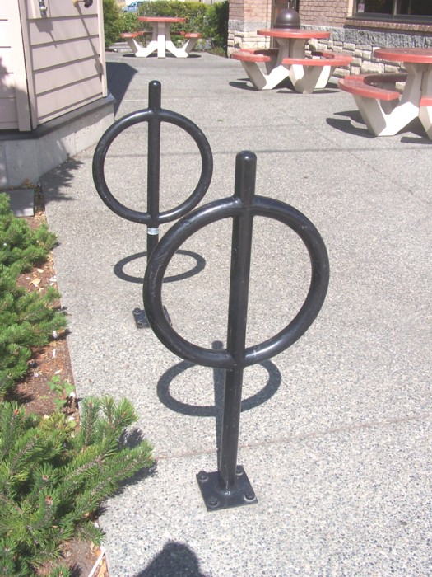
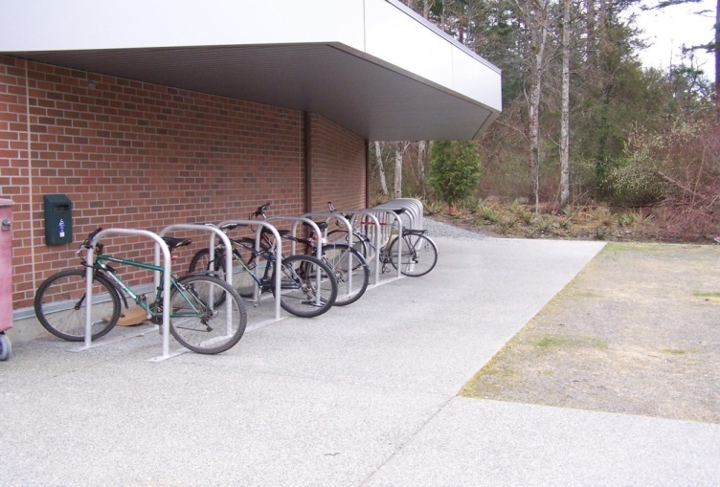
What do we need?
Post and Ring (right)
Inverted U (below)

Slide 12
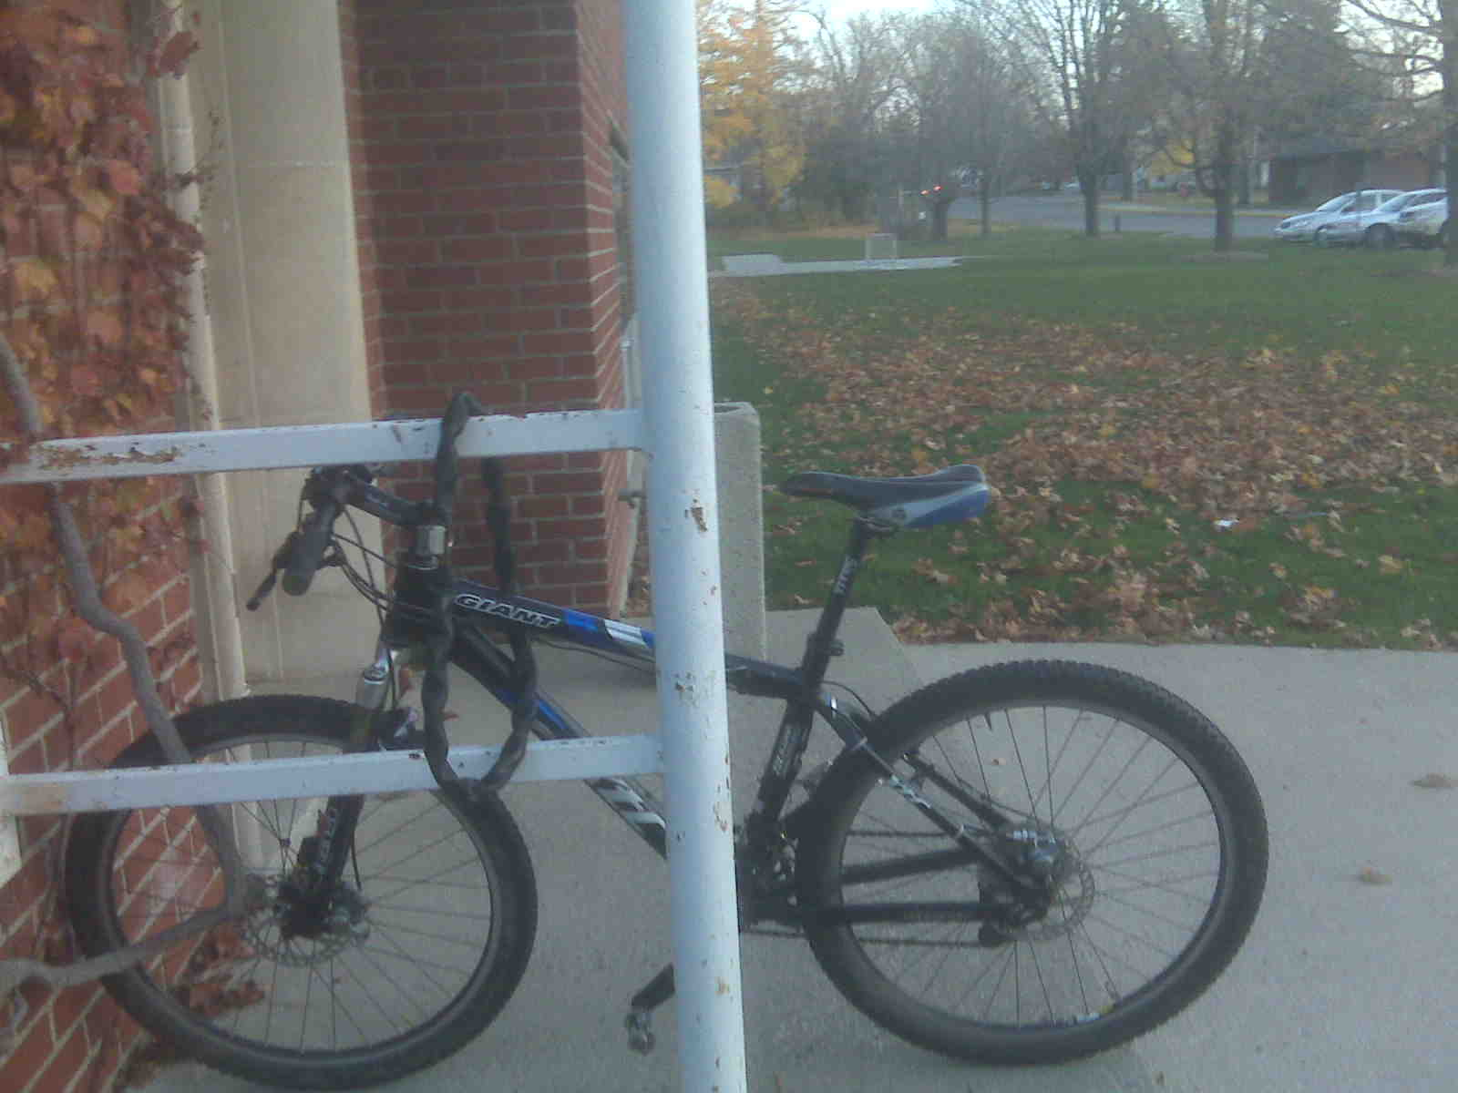
And no security offered

Slide 13
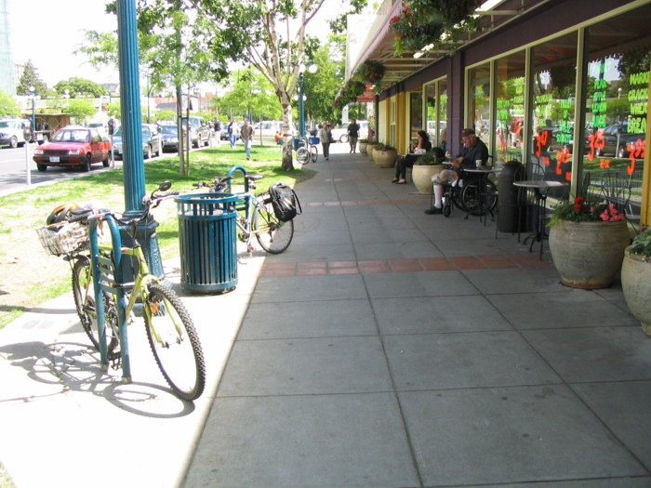
Successful installation
Good rack
Destination accessible
Visible
Minimal hazards

Slide 14
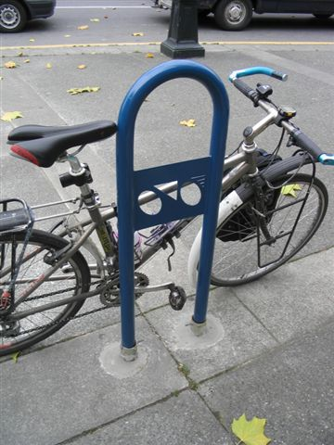
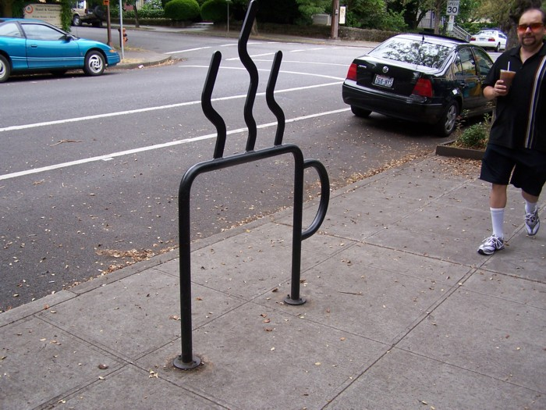
Combining good design & creativity

Slide 15
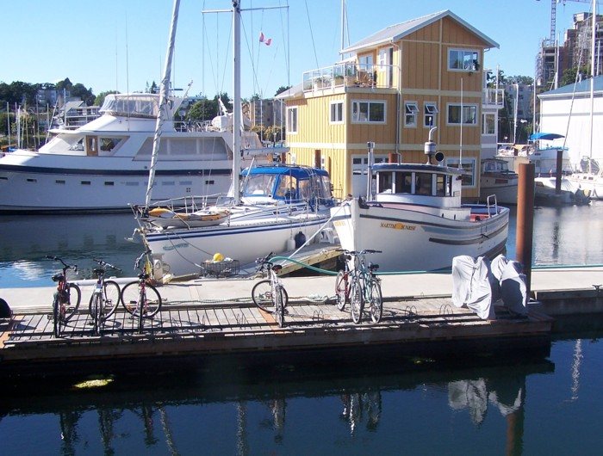
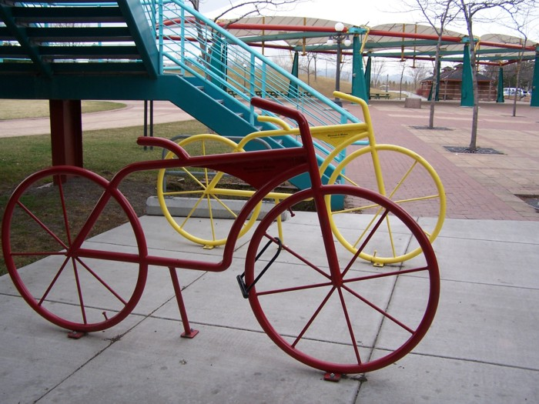
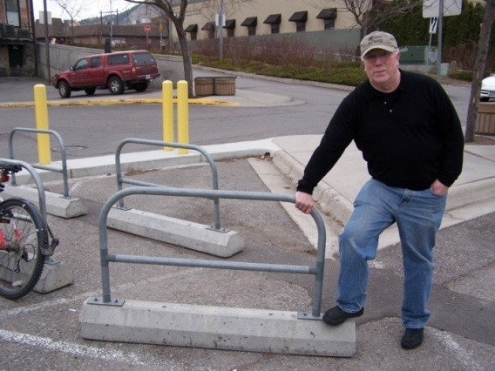
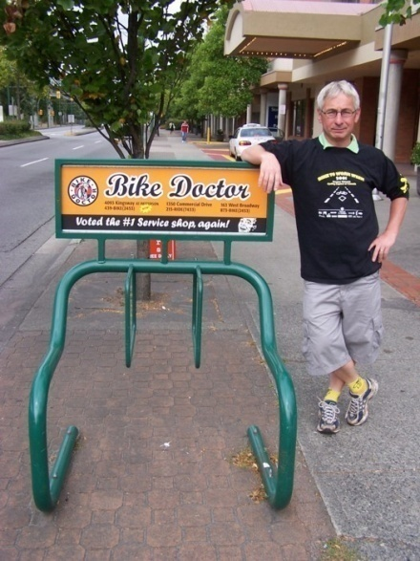
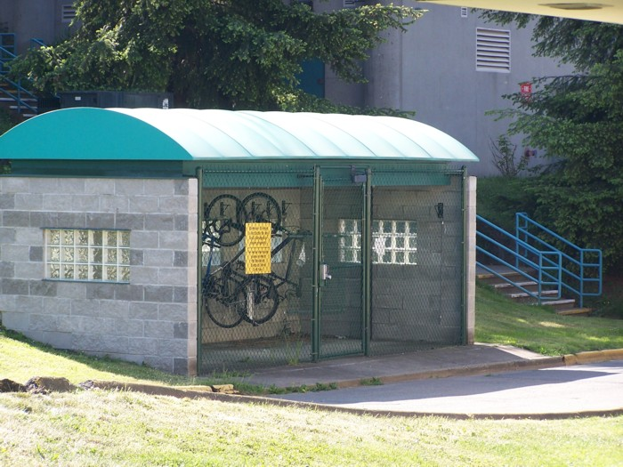
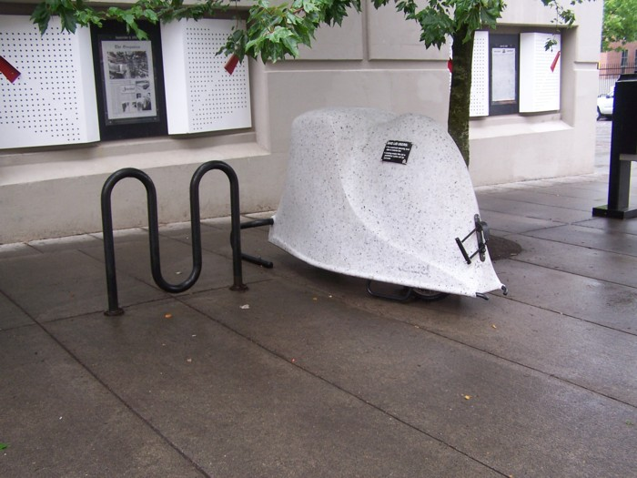

Slide 16
Active Communities Investments
Trails $1.0 M
Bike Lane $1.4 M
  $60,000 for bike racks
  $40,000 marking / education & signage
Public properties – libraries , Recreation facilities

Slide 17
Thanks are owed to…
John Luton, Executive Director, Capital Bike and Walk Society, Victoria, BC
John Jordan, Chatham
of detailed bike parking guidelines and the level of service concept have been aided by:
Bunt Engineering – supported presentation at ITE in Portland – best practices
Mountain Equipment Co-op – sponsors of our bicycle parking manual
Translink – co-sponsors of the bicycle parking manual and supporters of our “Bicycle Parking On-line” project – now in development

Slide 18
How you can help
Identify areas requiring bike racks
Sponsor bike racks
Promote community / business partnerships / participation
Notes:
Wallaceburg supplier is available

Slide 19
Discussion
Questions
Pssst - Ask if you’d like to see the planned cycle routes for C-K

Slide 20
Next steps
Municipal contact Tom Beaton, Manager, Parks, Cemeteries and Horticulture
  Email: tomb@chatham-kent.ca
  Tel: 519.350.3709
Your contact
Prepare recommendations
Notes:
The Municipality’s contact will change when we hire the Coordinator for the Active Communities and Trails programs
Seek to establish a designated contact person with the organization sponsoring the presentation
Commit to working with the organization’s contact to prepare a detailed plan how we can move forward.

Slide 23
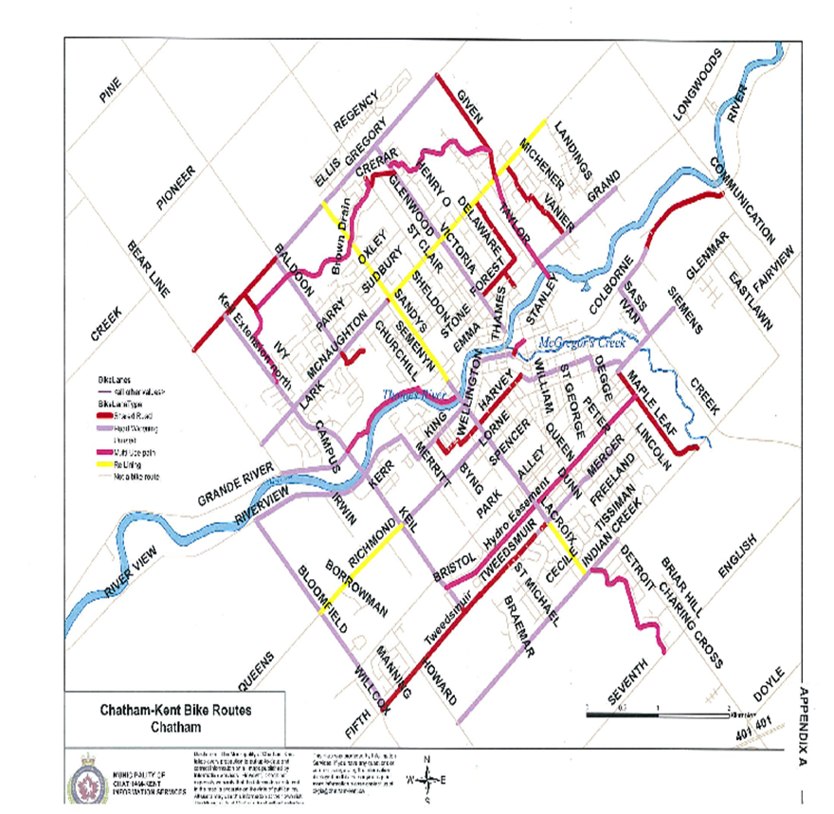

Slide 25
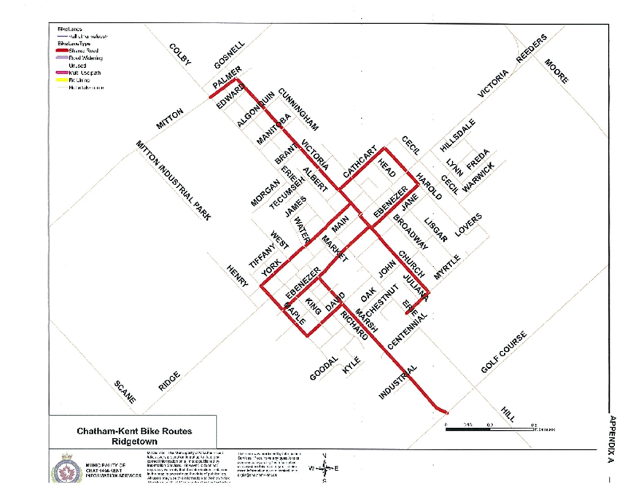

Slide 26
Thamesville
Off to a great start!
Notes:
I’ve been told by Nancy V. that there is no specific cycle paths for Thamesville, all roads were deemed to be safe. Leo please confirm / add any additional information. Thanks Don

Slide 27
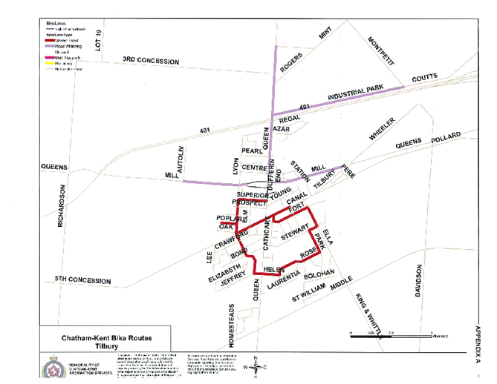

Slide 28
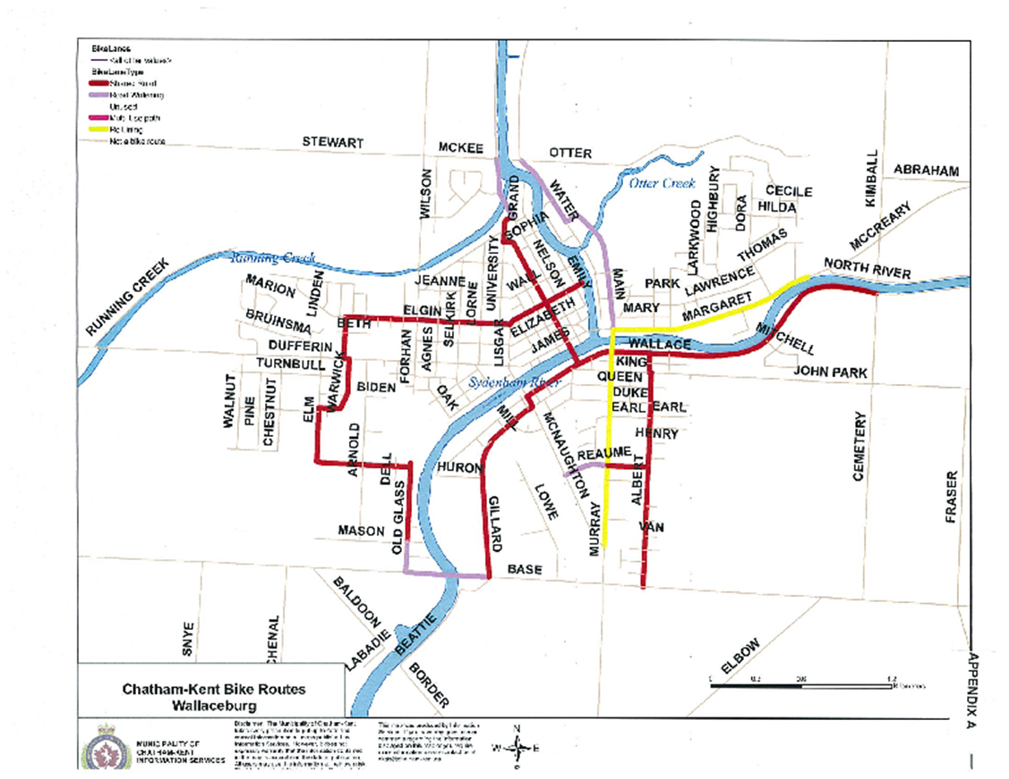

Slide 30
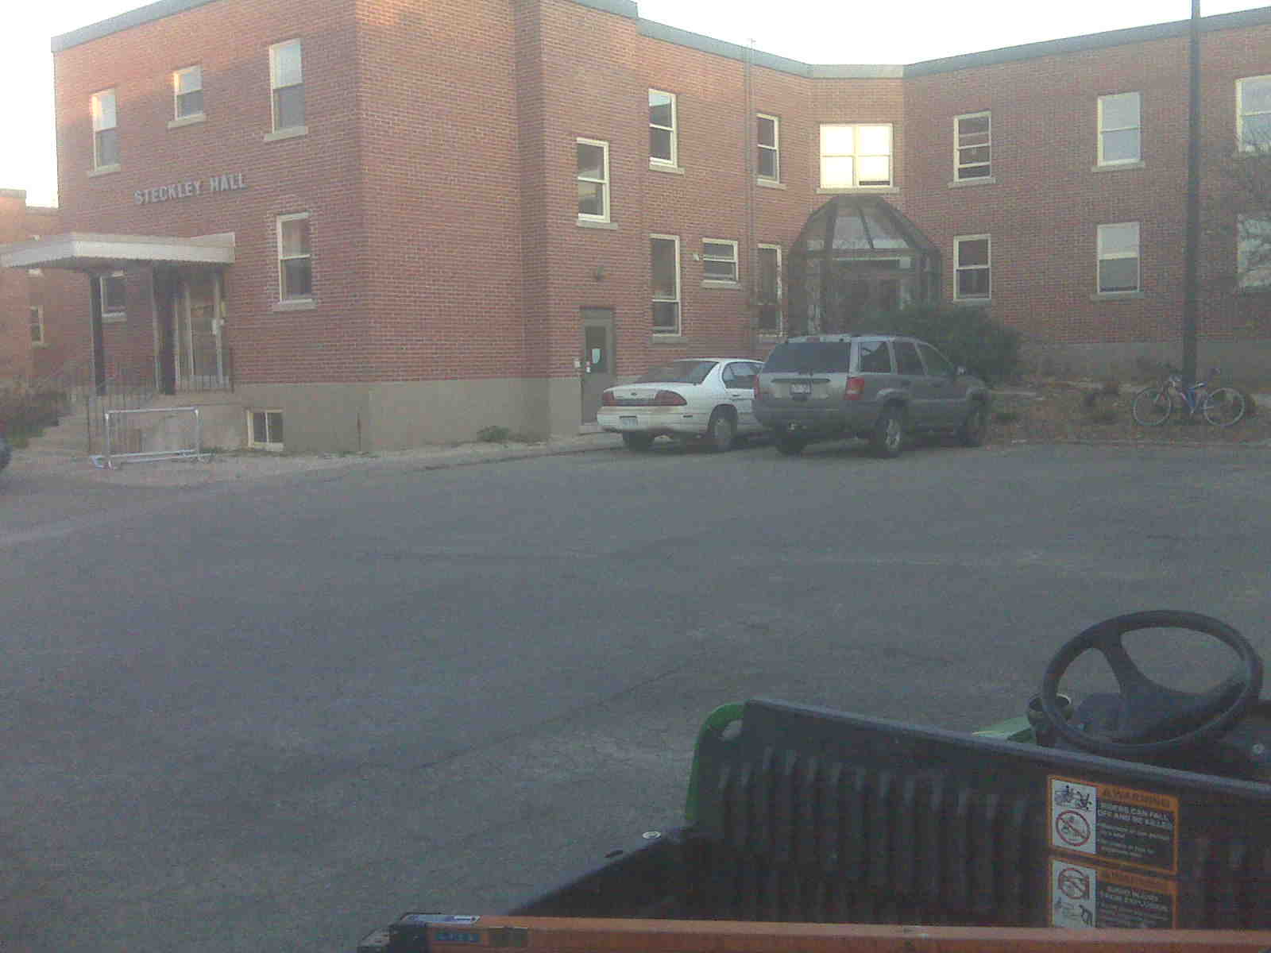
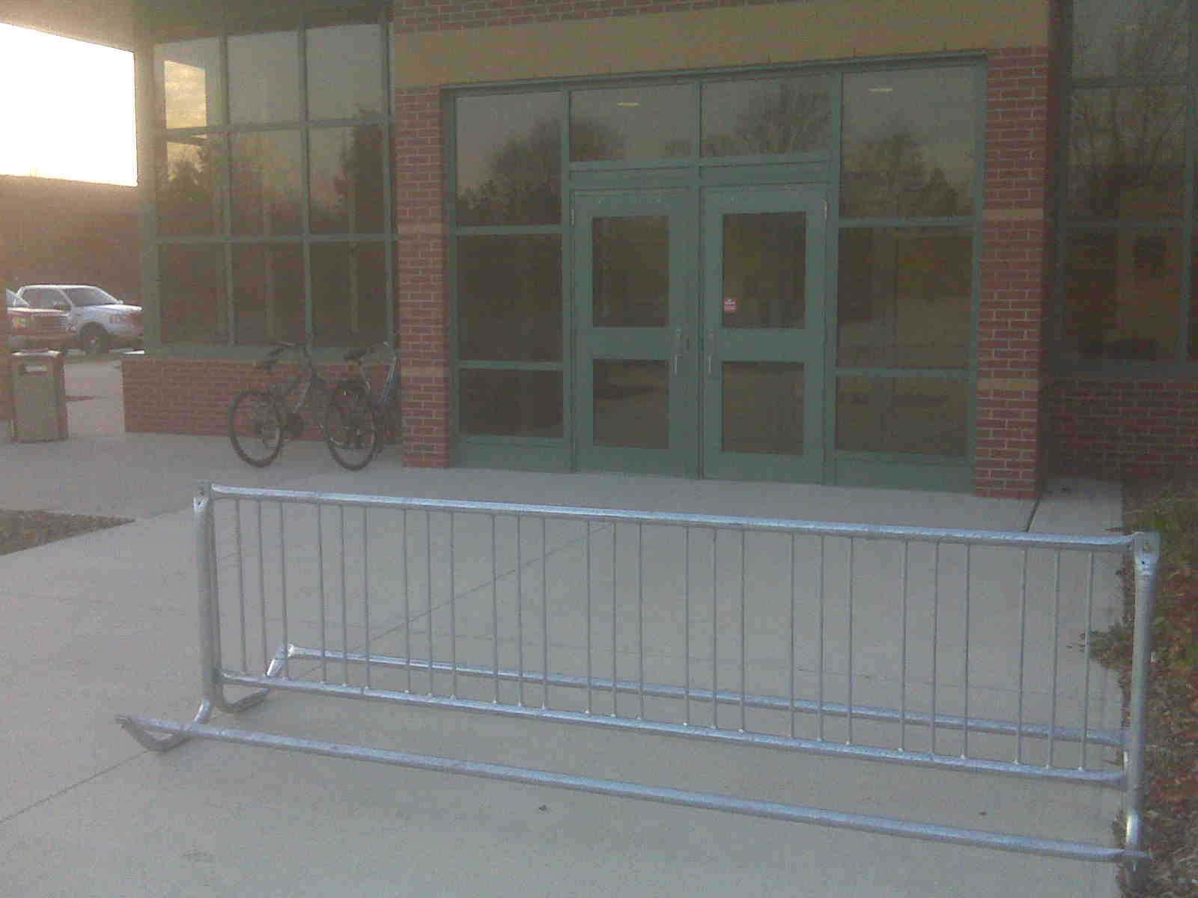
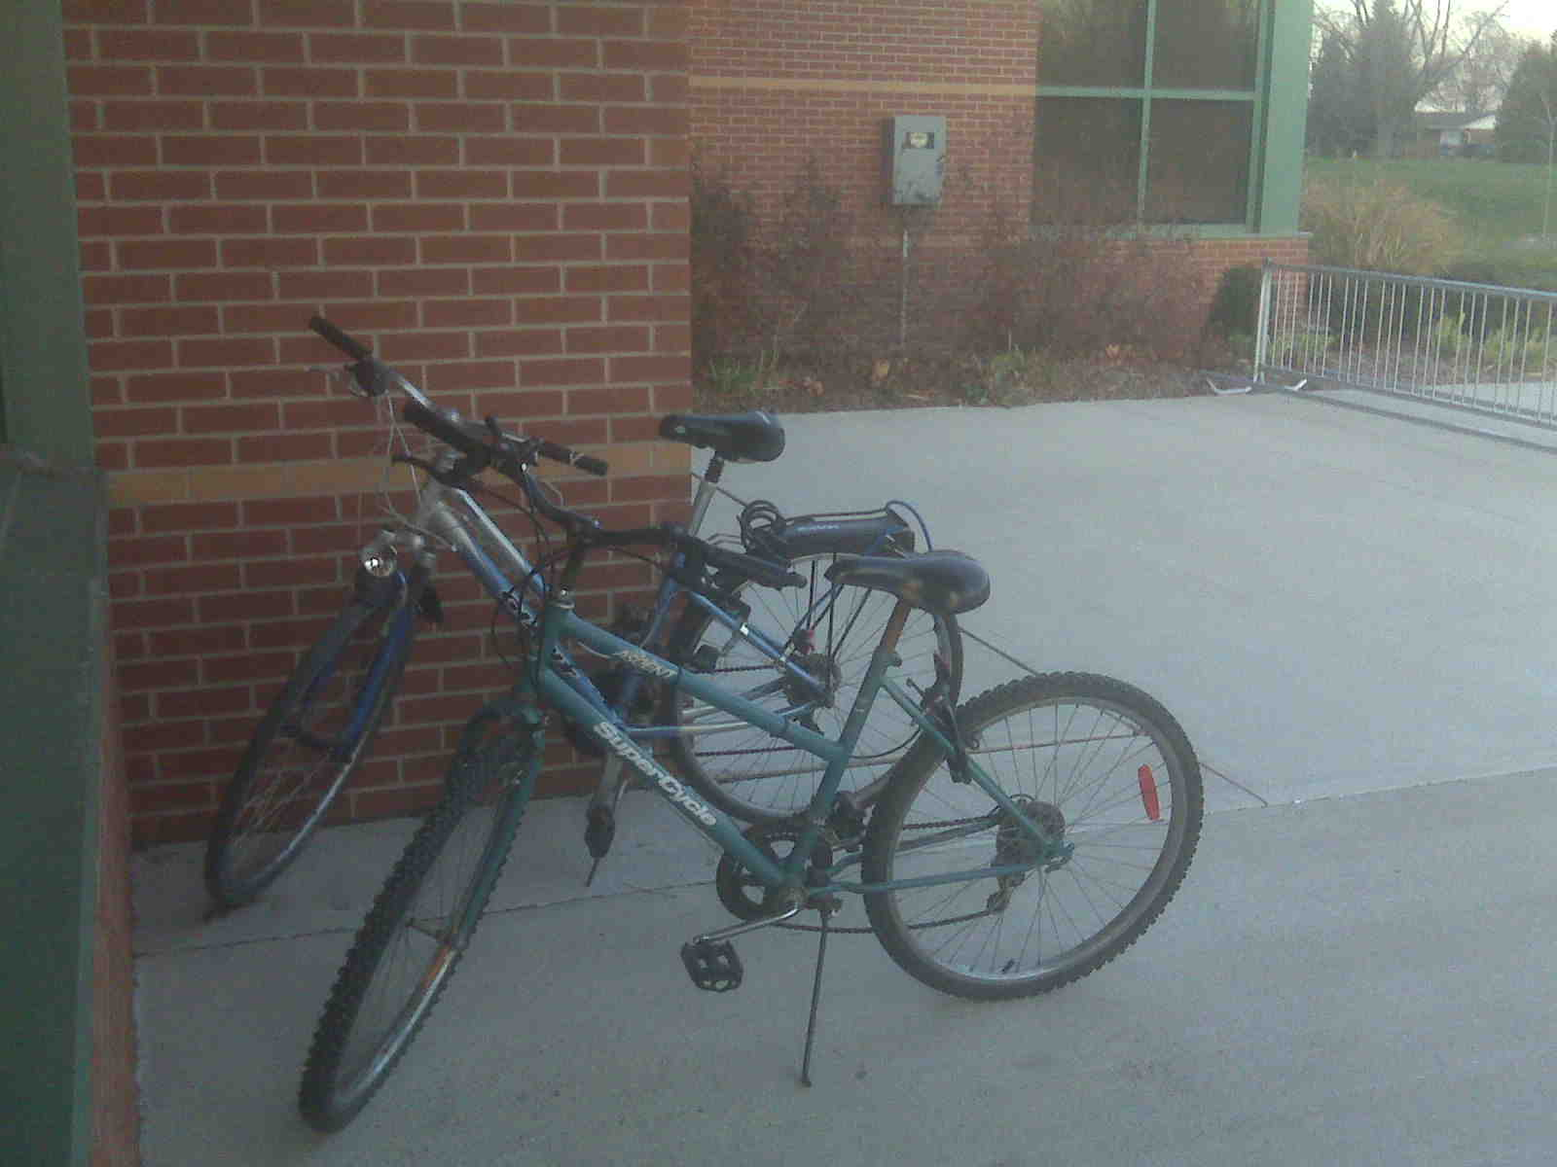
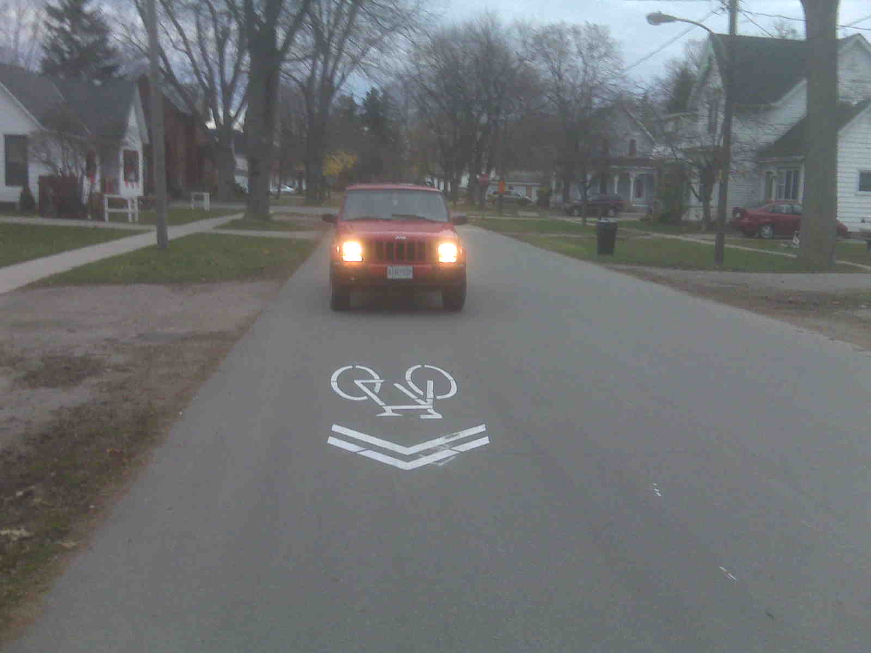
Oh Well, at least they are trying

Slide 31
